Slide 1
DL2: How it Works? A Multilayer Perceptrons (MLP’s) Example

Slide 2
Recap
In the previous lecture we broadly described neural networks as adaptive learning models based on the biological neuron model
In this lecture we describe the structure of a typical deep learning model using a simple MLP example, and describe how it works
A neural network usually consists of multiple interconnected layers, each layer consists of several neurons and feeds the next layer with some computed parameters
Data is passed at the input layer, then through all layers up to the output layer
In the process, the model learns how the input data is related to the expected outputs

Slide 3
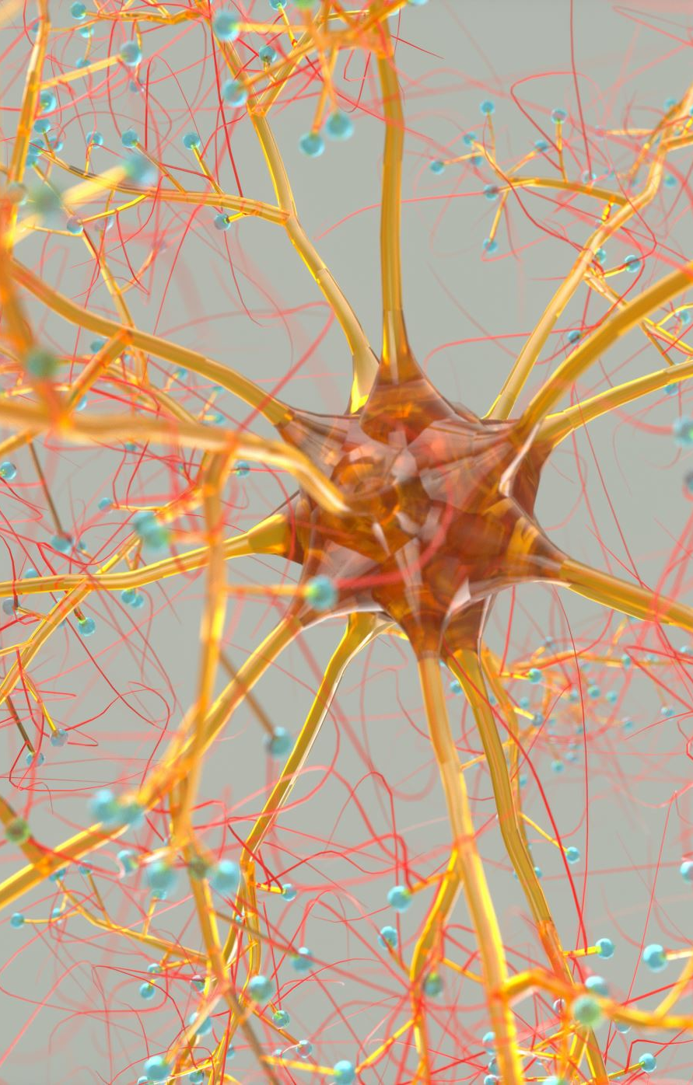
DL Model Structure
Structure of a Deep Learning Model: At its core, a deep learning model consists of layers of interconnected nodes, or neurons, which are modeled after biological neurons. These layers are typically organized into three types:
Input Layer: This is where data enters the network. Each neuron in this layer represents a feature of the input data.
Hidden Layers: Between the input and output layers, there are one or more hidden layers. These layers are where the complex computations and transformations of the data take place. Deep learning involves multiple hidden layers, hence the term 'deep'.
Output Layer: This layer produces the final output of the model, which could be a class label (in classification), a continuous value (in regression), or something else depending on the task.

Slide 4
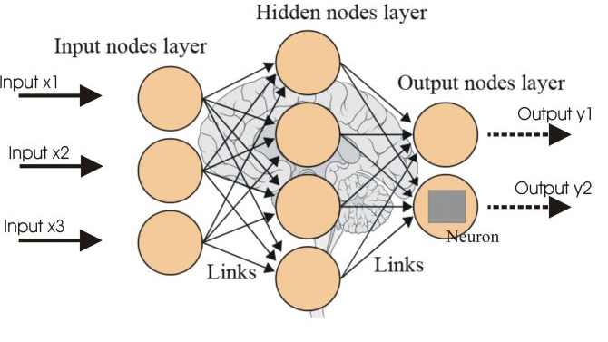

Slide 5
MLP Learning Process (Backpropagation)
While the data is passed through the network, the “model's output” is compared to the “desired output”, and the difference is measured using a loss function.
The model learns by adjusting the weights and biases to minimize this loss.
This is done through a process called backpropagation, where the error is propagated back through the network, allowing the model to understand which weights and biases need to be adjusted.
An optimization algorithm, like stochastic gradient descent, is used to make these adjustments in an efficient manner.

Slide 6
Tasks
Detection: In tasks like object detection in images, the network learns to identify the presence and location of objects within an image. This involves both classifying the type of objects and localizing them within the image.
Classification: In classification tasks, the network categorizes input data into predefined classes. For example, it might classify images as cats or dogs.
Prediction: In predictive tasks, the network makes predictions about future data points based on learned patterns from past data. This is common in time series analysis, like stock price prediction.
Generation: Generating New Novel Content

Slide 7
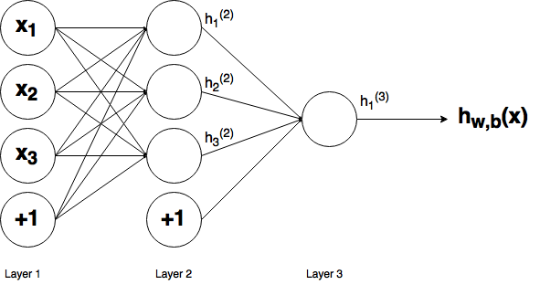
A Simple Example

Slide 8
Learning
To Learn. The ANN needs:
A Learning process
A Learning (optimization) algorithm
A loss (cost function) to measure the difference between actual and expected results
An activation function to control the learning rate

Slide 9
MLP’s
There are many types of neural network models – and many more will be appearing over the years
The most popular, basic ANN model is the MLP
Consists of one input layer, one output layer and many hidden layers (from 1 to n)

Slide 10
A Simple MLP with one Hidden Layer

Slide 11
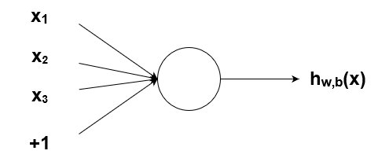
The Perceptron
h=x₁w₁+x₂w₂+x₃w₃+b

Slide 12
A Simple Activation Function for the Perceptron
w1 = 0.5
w2 = 1.0
w3 = 2.0
l1 = 'w = 0.5'
l2 = 'w = 1.0'
l3 = 'w = 2.0'
for w, l in [(w1, l1), (w2, l2), (w3, l3)]:
f = 1 / (1 + np.exp(-x*w))
plt.plot(x, f, label=l)
plt.xlabel('x')
plt.ylabel('h_w(x)')
plt.legend(loc=2)
plt.show()

Slide 13
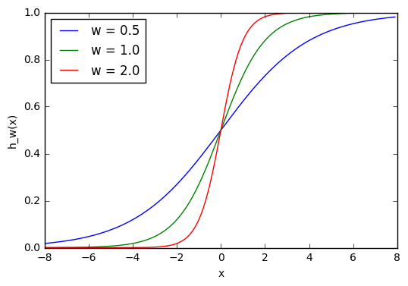
Activation function plot

Slide 14
Learning
Learning is achieved by adaptively modifying the weight based on the value of the Loss ,Function (difference between the target value and the actual computed value)
The modification per weight is computed using gradient descent, an algorithm that will be explained later

Slide 15
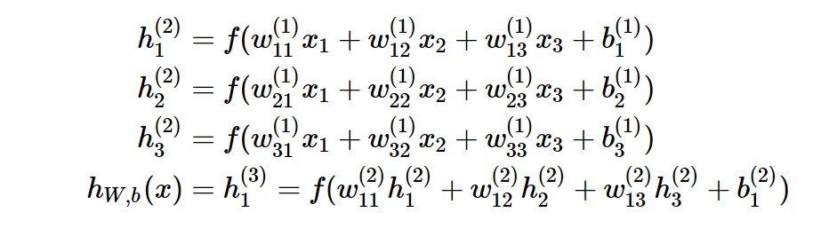
Computing the Weights in MLP’s

Slide 16
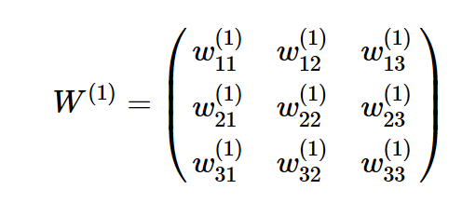
Layer 1 Weights

Slide 17
Python NumPy Representation
import numpy as np
w1 = np.array([[0.2, 0.2, 0.2], [0.4, 0.4, 0.4], [0.6, 0.6,0.6]])

Slide 18
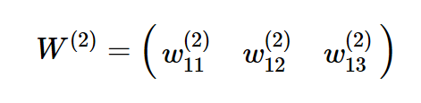
Layer 2 Weights

Slide 19
Python NumPy Representation
w2 = np.zeros((1, 3))
w2[0,:] = np.array([0.5, 0.5, 0.5])
The bias:
b1 = np.array([0.8, 0.8, 0.8])
b2 = np.array([0.2])

Slide 20
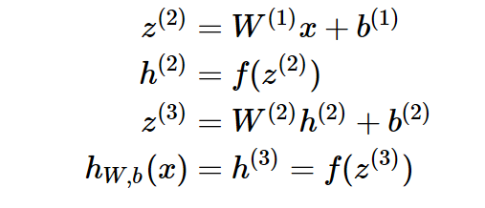
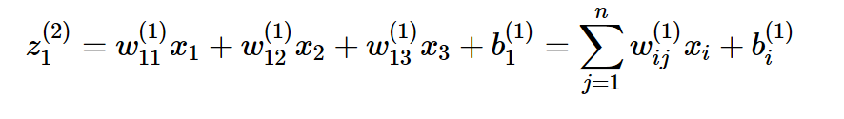
Vectorization
The upper box shows the vector representation for expressions like the one in the bottom

Slide 21
Implications – Power NumPy (Tensors)
This how matrix Multiplication in NumPy
This is the implementation of the forward Path of our neural network
def matrix_feed_forward_calc(n_layers, x, w, b):
for l in range(n_layers-1):
if l == 0:
node_in = x
else:
node_in = h
z = w[l].dot(node_in) + b[l]
h = f(z)
return h

Slide 22
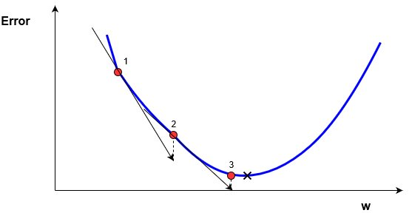
Gradient Descent

Slide 23
A Simple Example: Loss Function and Learning Algorithm
x_old = 0 # The value does not matter as long as abs(x_new - x_old) > precision
x_new = 6 # The algorithm starts at x=6
gamma = 0.01 # step size
precision = 0.00001
def df(x):
y = 4 * x**3 - 9 * x**2
return y
while abs(x_new - x_old) > precision:
x_old = x_new
x_new += -gamma * df(x_old)
print("The local minimum occurs at %f" % x_new)

